Slide 1

Department of
Electronics and Telecommunication
Project on
“Alumni Management Portal .”
By
1. Dhangar Yadnynesh K. (B400090102)
2. Gudgal Aniket N. (B400090112)
3. Kulkarni Shubham M. (B400090129)
Guided By
Prof. C.K. Kalawade (Associate Professor, E&TC)
Coordinator
Prof. J.P.Botkar
(Department E&TC)
Head of Department
Dr. A.K.Patil
(Head of Department E&TC)
Principle
Dr. U.P.Naik
(D.V.V.P. COE Ahmednagar)

Slide 2

Introduction
Networking Opportunities: Alumni portals provide a platform for graduates to connect with their peers, mentors, and faculty, fostering professional and personal networks that can support career growth and collaboration.
Career Development: Many alumni portals offer job postings, career guidance, and mentorship programs, enabling graduates to explore new opportunities and seek advice from experienced professionals in their field.
Event Updates and Participation: Through the portal, alumni can stay informed about reunions, seminars, webinars, and other department events, ensuring continued engagement with their alma mater.
Knowledge Sharing and Collaboration: Alumni can contribute to knowledge-sharing by posting articles, hosting webinars, or engaging in discussions, creating a dynamic and supportive community for both current students and fellow graduates.

Slide 3






Technology Stack
Is used to style and layout web pages for example, to alter the font, color, size, and spacing of your content, split it into multiple columns, or add animations and other decorative features.
Is a high-level Python web framework that enables rapid development of secure and maintainable websites. Built by experienced developers, Django takes care of much of the hassle of web development.
Is a set of markup symbols or codes inserted into a file intended for display on the internet. tells web browsers how words and images should be displayed on a webpage.
JavaScript is a scripting language used to develop web pages. and allows developers to create a dynamic and interactive web page to interact with visitors and execute complex actions.
MySQL is a relational database that stores information in tabular form, with rows and columns representing different data attributes and the various relationships between the data values.

Slide 4
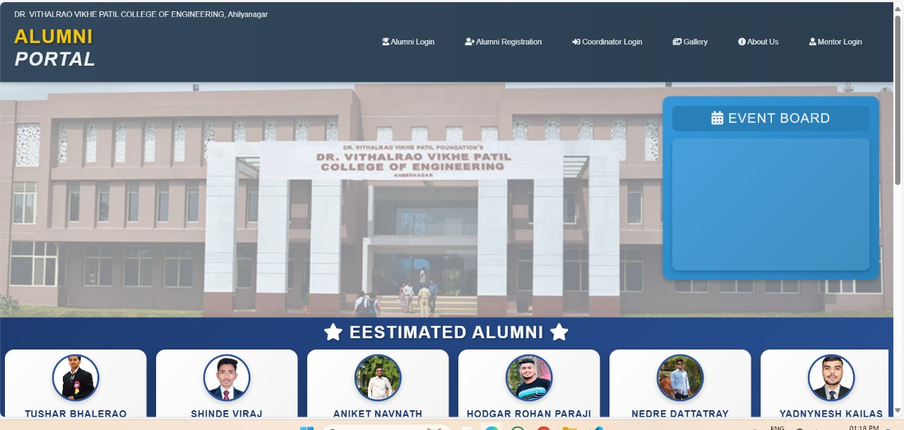

Slide 5
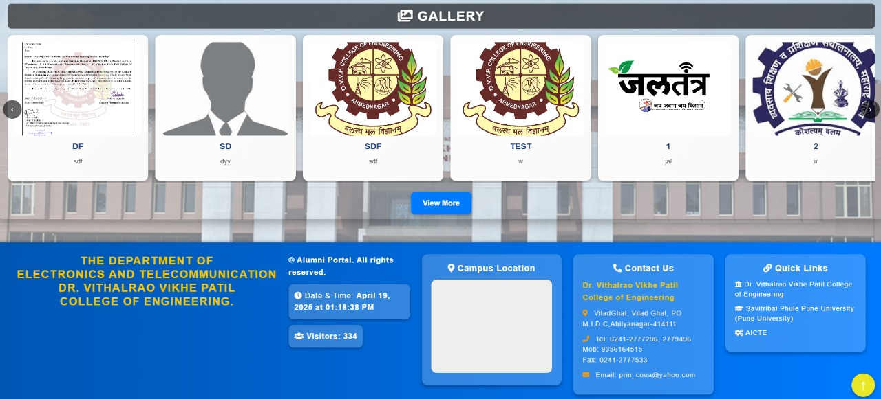

Slide 6
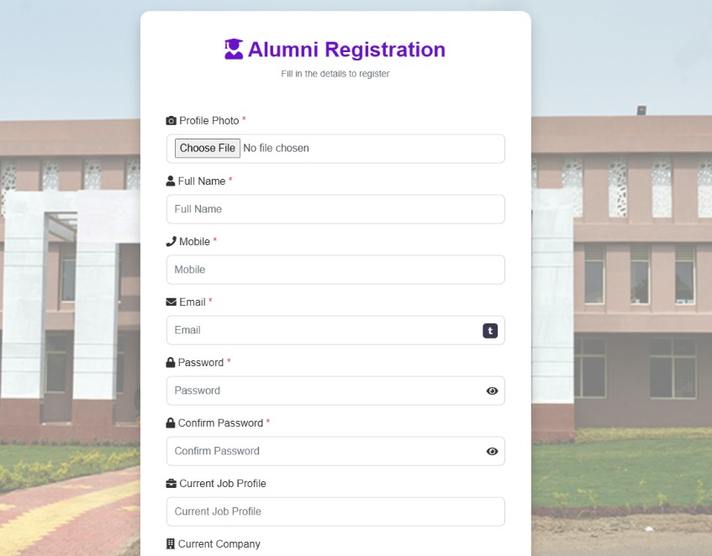
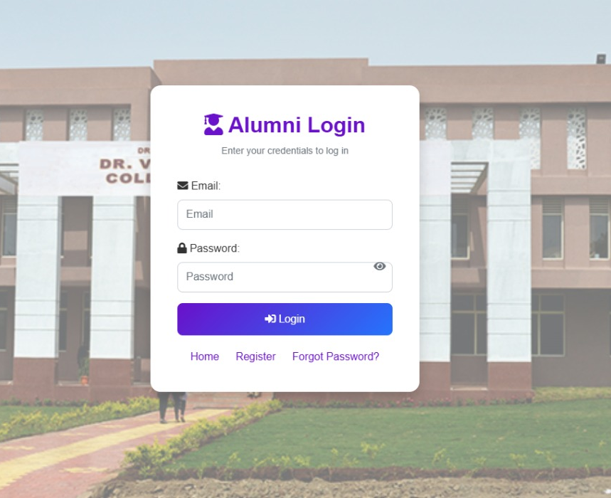

Slide 7
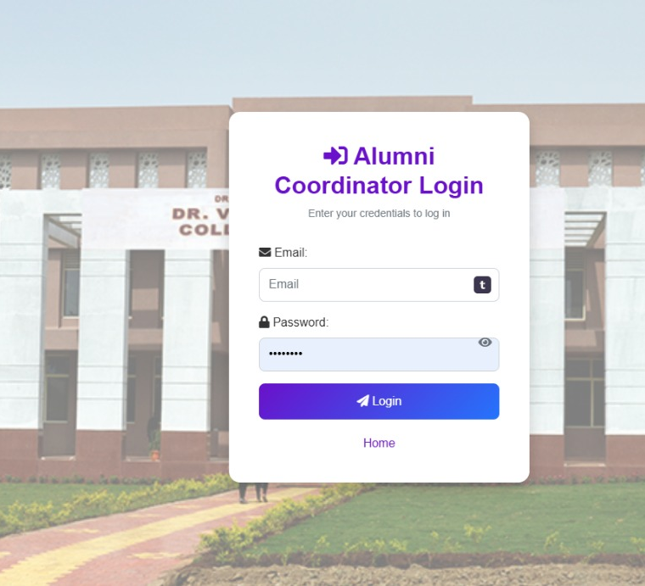
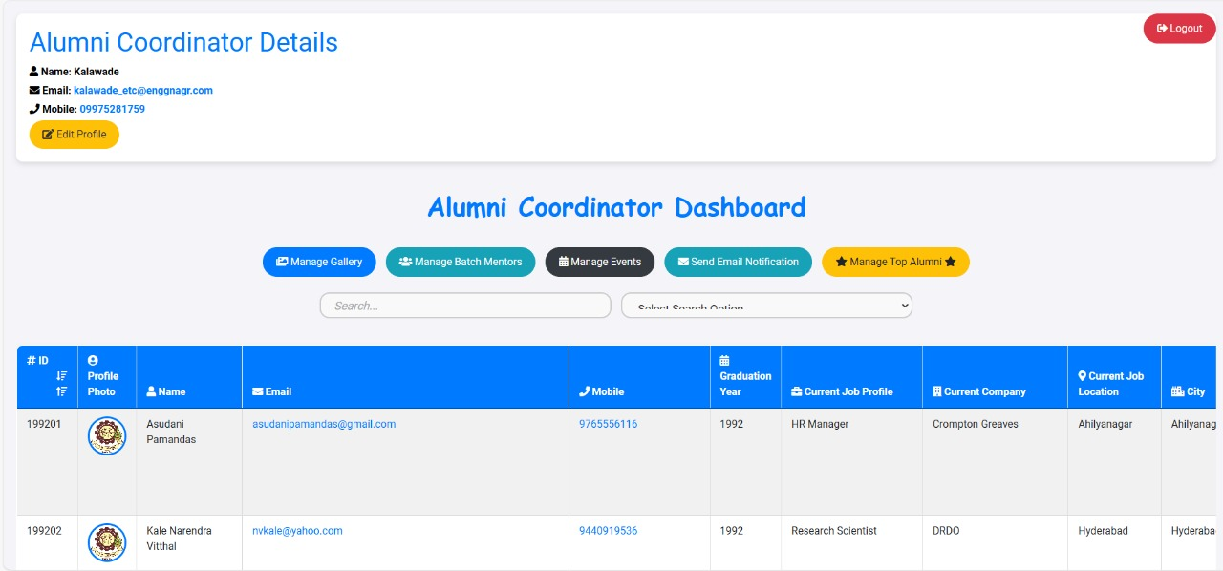

Slide 8
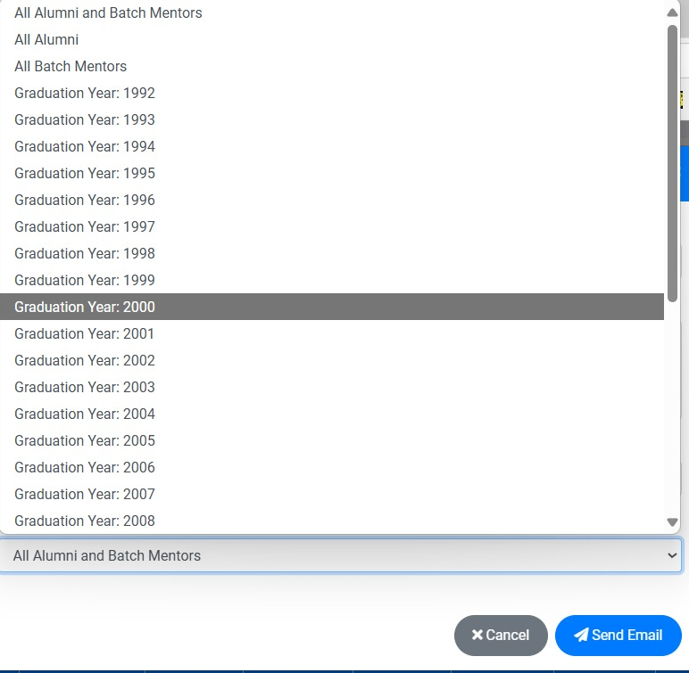
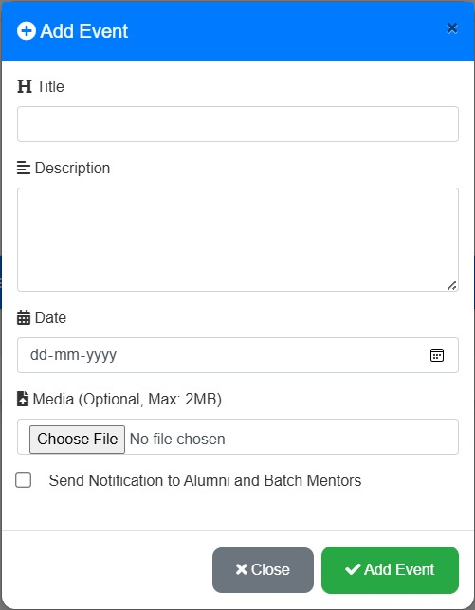
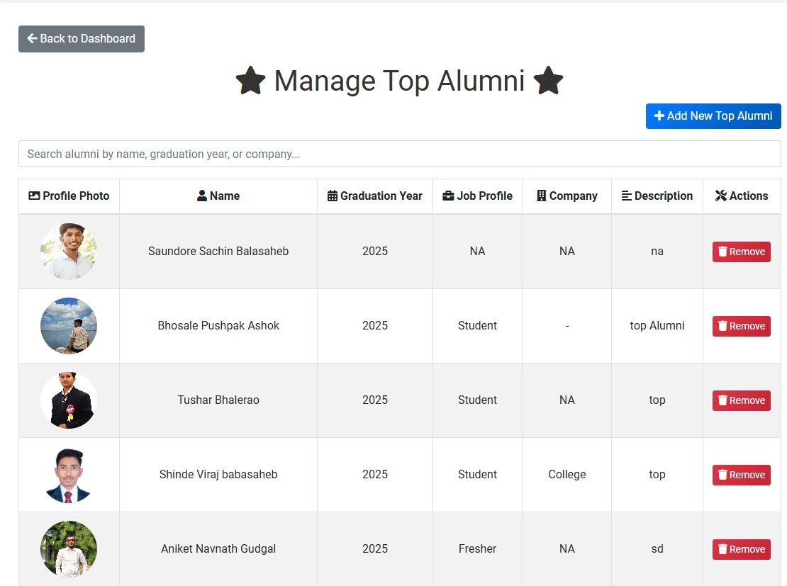
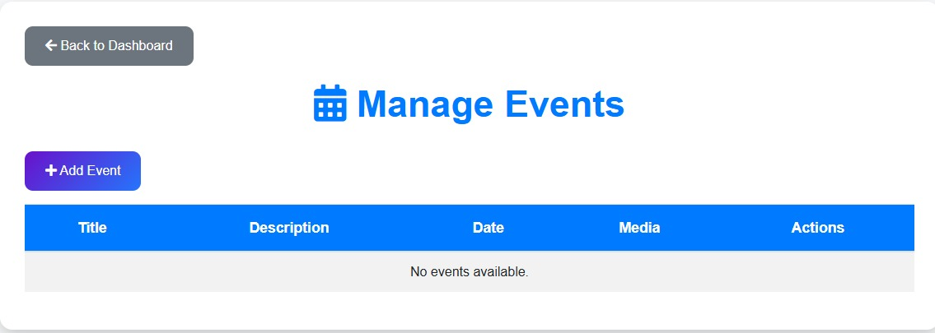

Slide 9
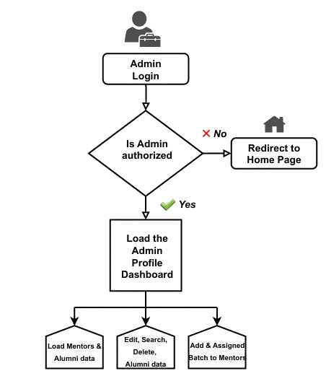

Flow Block Diagram
Administrator / Admin Flow

Slide 10

Literature Survey
1
IIT Kanpur
IIT has Gallery with many images, Lectures details with specific day and time; contacts which show whom all are connected with this portal, woman alumni convention as separate for the woman only on the Home page. And Features are Gallery present on the home page; visit for guide allocations is given so that the junior student can get the solution or the advice for their difficulties.
2
Prof. P.S Lokhande
Alumni portal application is to allow old and new students of the college to have communication. students to have interaction with the alumni of the college for getting various updates on current industry trends, Internship opportunity, sponsored projects and various referrals opening in the corporate world.
3
Parth P.
This research paper presents the development and implementation of the "Alumni Connect Hub," a web-based alumni management system for [Sipna College of Engineering and Technology Amravati]. Designed to facilitate seamless interaction and information exchange among alumni, students, and staff, the system aims to cultivate a strong and engaged alumni community within the institution.

Slide 11


Objectives of the Project
Main Objective: To develop an Online Alumni Management System.
Specific Objectives:
To review literature and conduct field study about the existing alumni management systems.
To design an Online Alumni Management System.
To implement the system based on the design.
To test and validate the system based on the requirements.
This project help alumni and department of send or receive notification or information.
Automating the management and storage of alumni information.
In this project we developed an Alumni Information and Management with various technologies which helps to keep a track of Alumni current status and pave the way for interaction.

Slide 12
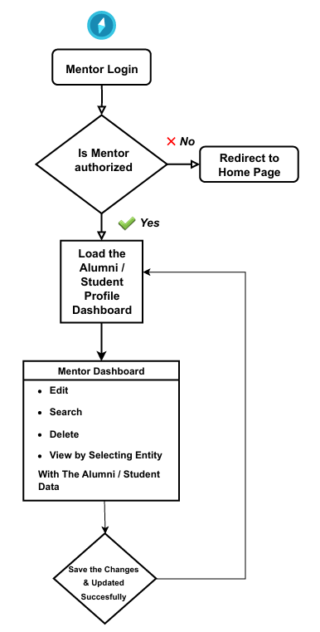

Mentors Flow

Slide 13

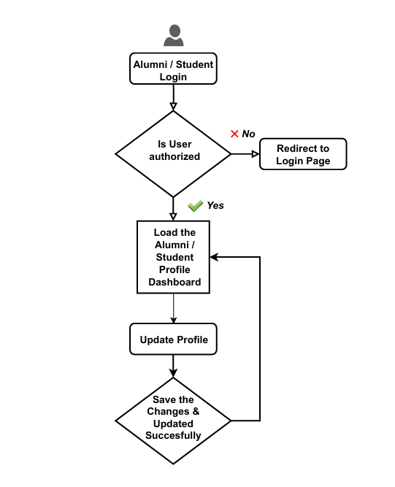
Alumni / Student Flow

Slide 14
Seamless Registration
with Email Confirmation
01
05
Engagement through
Social Connectivity
The Alumni
Management
Portal
Alumni receive an automated welcome email
after successful registration
for verification and onboarding.
Boosts alumni interaction via integrated
social media links, making it easy
to connect and communicate.
Interactive Alumni
Showcase and Profile Sharing
02
04
Smart Event and
Notification System
Highlights top alumni on the homepage and
provides structured, shareable profile templates
with social media links for direct contact.
Notifies users about upcoming college/department
events and allows admins to send targeted or
mass email notifications to alumni batches.
03
Dynamic Gallery and Notice Board
Includes a department gallery for memories and achievements,
alongside a virtual notice board for important announcements.

Slide 15


Limitations and Future Scope
Integration of virtual alumni meetings and interactive online events.
Personalized chat and active status indicators for real-time interaction.
Expanded options for job postings, internships, and sponsored projects.
Implement the android and IOS application.
Addition on the direct WhatsApp messages & Email to the alumni.
Tools for entrepreneurial guidance and mentorship in specific industries.
Access to online expert lectures, webinars, and ongoing professional development.
Personalized chat and active status for users.
Internship, job, and industry-sponsored project listings.

Slide 16


Conclusion
We are developing alumni web application to established interaction between alumni and department. This web application is developing in Word press with the help of some inbuilt plugins and some own developed plugins. The web application serve as a useful site to any department and Alumni to know what is going on in our department and can also know about the various opportunities of the outer world to the institute. This portal provides access to only authorized users.

Slide 17

References
“Alumni Connect Hub: A Comprehensive Alumni Management System” Parth P. Sawai1, Prajyot V. Chambhare2, Aditya N. Jaysingpure3, Atharav G. Karhe4, Disha Rathod5, Dr V S Gulhane6, ISSN (Online): 2583-648X
"Harvard Alumni" [online]. Available: http://www.alumni.harvard.edu
“Design of Alumni Portal with Data Security” ,August 2021, DOI: 10.1109/ICESC51422.2021.9532986, Babu M, Sandhiya K, Preetha V, Sankara Eshwari S, Ramya Chitra M
“College Alumni Portal” , Shaikh Asiya1 Shaikh Tuba2 Siddiqui Maryam3 Momin Alimuddin4 Prof. P.S Lokhande5, | Vol. 3, Issue 09, 2015 | ISSN (online): 2321-0613
"IIT Kanpur Alumni" [online]. Available: www.iitkalumni.org
"Alumni Princeton University" [online]. Available: www.alumni.princeton.edu
"ITMB Alumni Association" [online]. Available: www.alumni.itmb.edu
"UCLA Alumni" [Online]. Available: www.alumni.ucla.edu
Cecilia A. Mercado and Gerry Paul C. GenoveTowards Overcoming Limitations of Community Web Portals: a Classmates’ Example DERI – Digital Enterprise Research Institute, University of Innsbruck, Austria, and National University of Ireland at Galway, Ireland Anna V. Zhdanova
Security Mechanism in Alumni Portal Department of Information Technology, Xavier Institute of Engineering, Mahim (W), Mumbai, India Vikrant Pawar , Sagar Date, Suraj Iyer, Chhaya Narvekar
Campus Portals: Supportive Mechanisms for University Communication, Collaboration, and Organizational Change David L. Eisler, Provost Weber State University.
Chiang Y. Ch.; Ahmad F.M. A.; Wong S. L., (2010), "Students’ readiness in using mathematics online portal: a preliminary study among undergraduates ", journal Procedia Social and Behavioural Sciences, ISSN 677-681.
C. Skrzypek, J. Diebold, W. Kim, D. Krause, “Mentoring Connections: Implementing a Student–Alumni Mentor Program in Social Work,” Journal of Social Work , vol. 55, no. 3, May 2019, pp. 449-459, https://doi.org/10.1080/10437797.2019.1600445
Council for Advancement and Support of Education (CASE), “CASE Insights on Voluntary Support of Education,” https://www.case.org/research/surveys/case-insights-voluntary-support-education.

Slide 18
E. Rosenkrantz, “Changing Landscape of Alumni Engagement: Comparative Case Study of Research 1 Institutions with Changing Demographics,” Doctoral Dissertation, Northern Arizona University, May 2023.
J. A. McCall, P. K. Richards, G. F. Walters, “Factors in Software Quality: Concepts and Definitions of Software Quality,” Technical Report, General Electric Company, Sunnyvale, CA, USA, vol. 1, November 1977, https://apps.dtic.mil/sti/pdfs/ADA049014.pdf.
International Organization for Standardization, “ISO/IEC 25010:2011 Systems and software engineering - System and software Quality Requirements and Evaluation (SQRE): Quality models,” https://iso25000.com/index.php/en/iso-25000-standards/iso-25010.
R. S. Mission, “Multi-channel Support and Ticketing Interface for Online Support Management System Platforms”, International Journal of Applied Science and Engineering, vol. 18, no. 4, May 2021, doi:10.6703/IJASE.202106_18(4).006.
K. A. S. Secugal, J. P. Sermeno, N. E. Mistio, “QR-Code Tracking and SMS Notification Transaction Interface for Scholarship Management System,” International Journal of Applied Science and Engineering, vol. 18, no. 4, May 2021, pp. 1-8, https://doi.org/10.6703/IJASE.202106_18(4).004.
E. A. Smith, G. D. Gearhart, M. T. Miller, “Understanding Alumni Relations Programs in Community Colleges,” International Journal of Higher Education, vol. 8, no. 5, October 2019, pp. 176-184, https://doi.org/10.5430/ijhe.v8n5p176

Slide 19
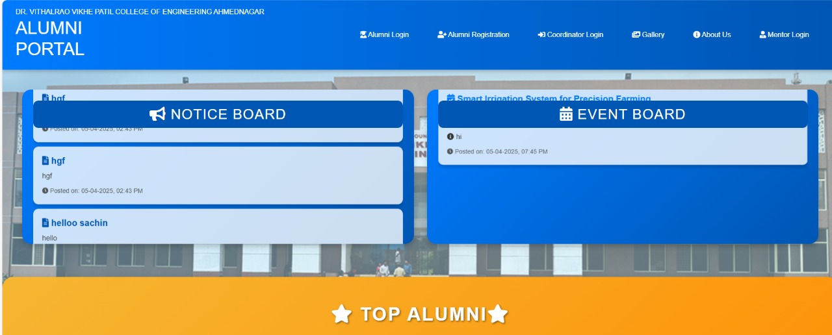

Slide 20
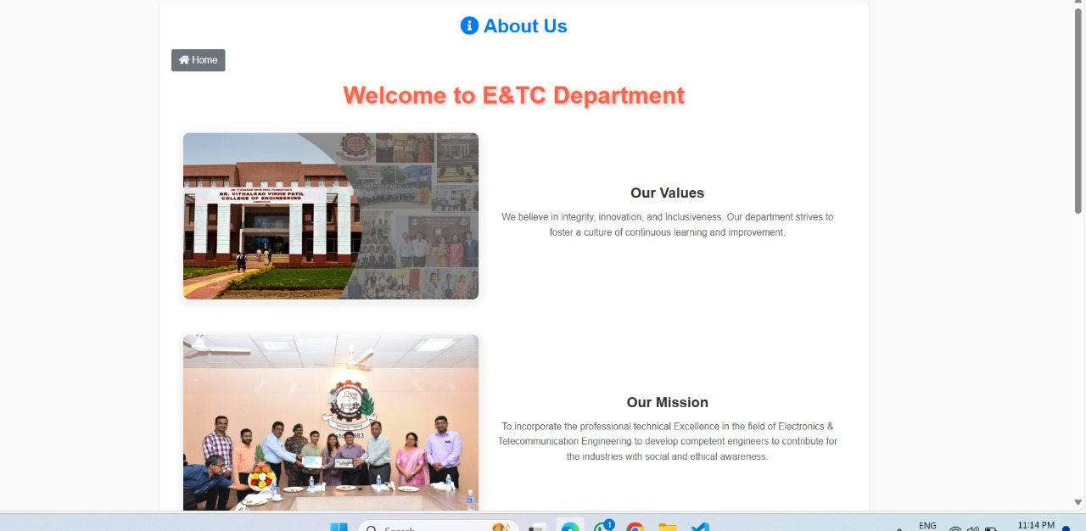

Slide 21
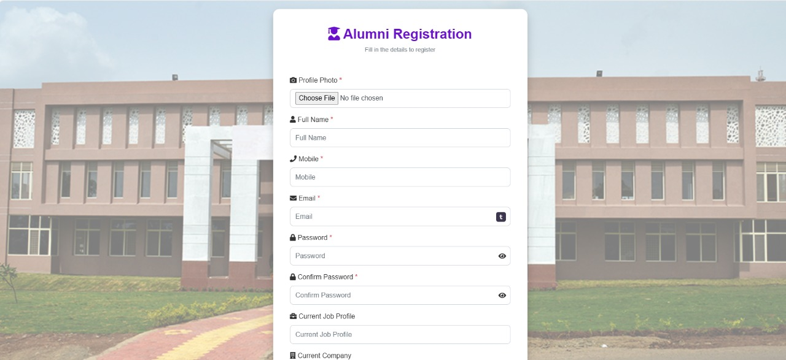

Slide 22
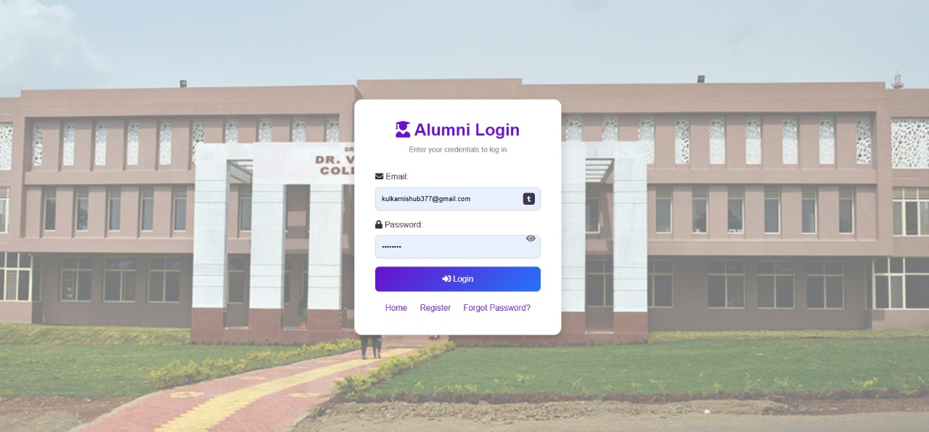

Slide 23
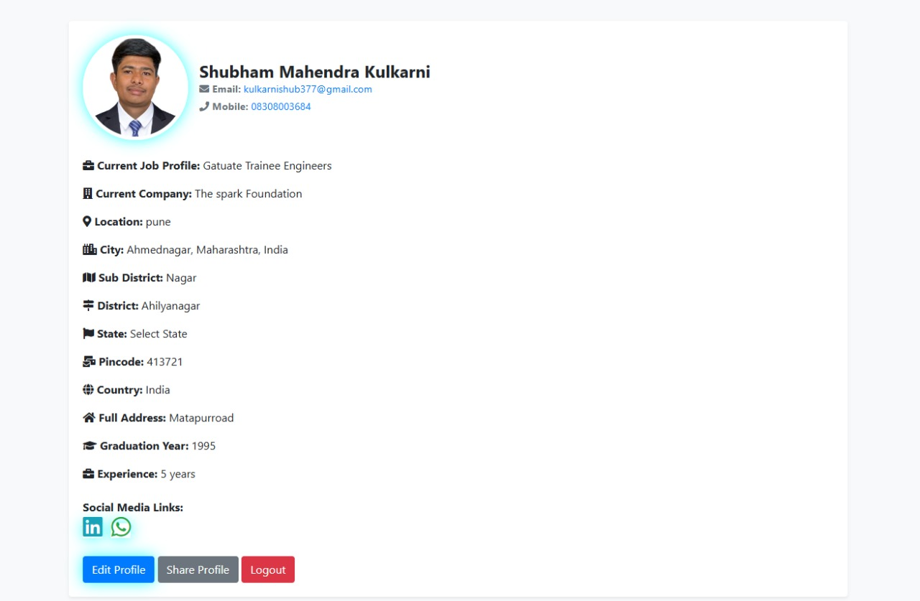

Slide 24
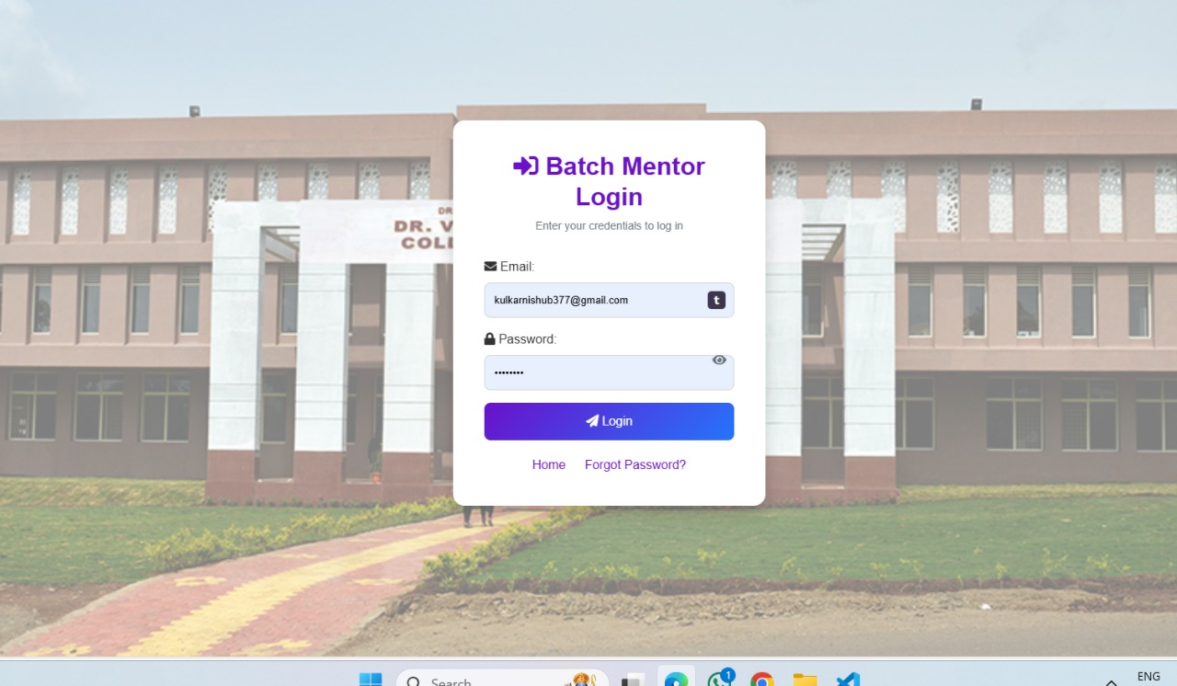

Slide 25
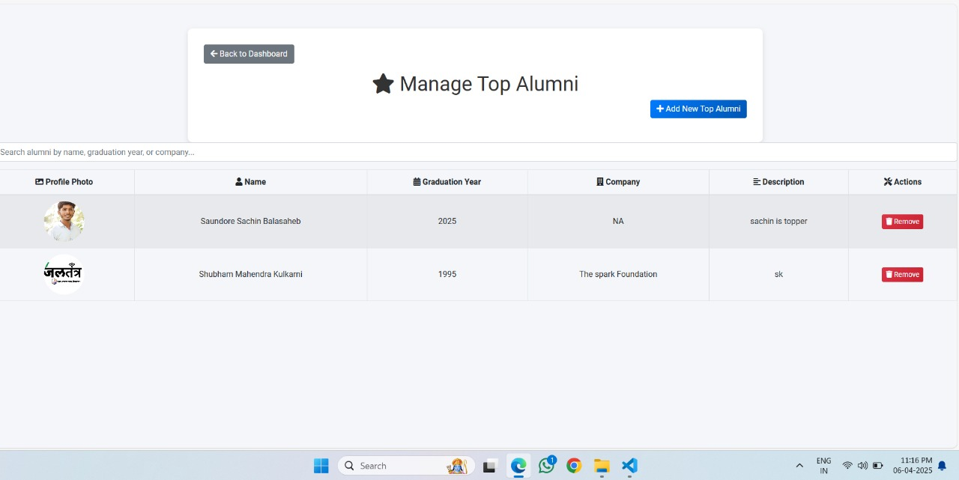

Slide 26
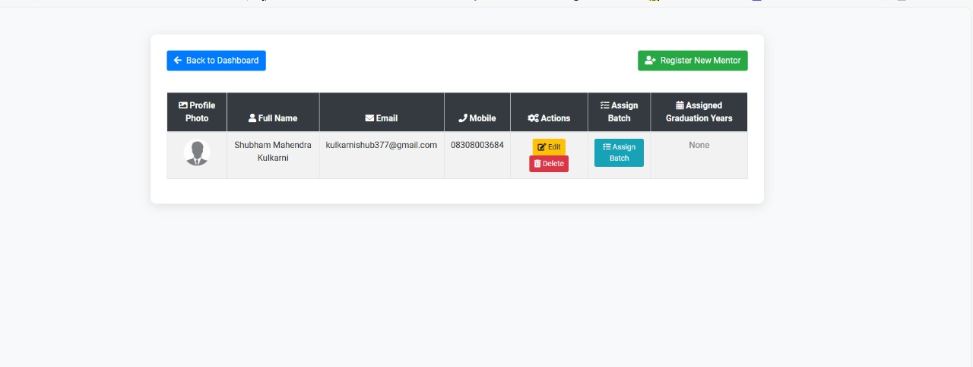

Slide 27
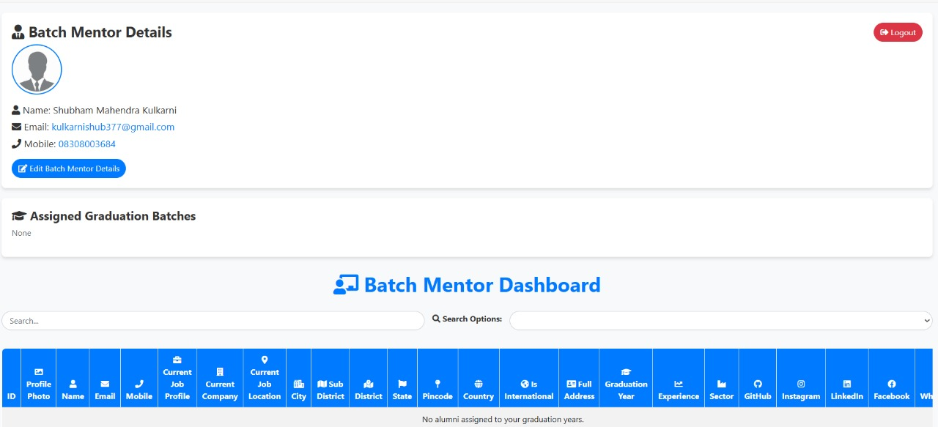

Slide 28


Slide 29

Any Question ?
Any Question On our Project

